Slide 1

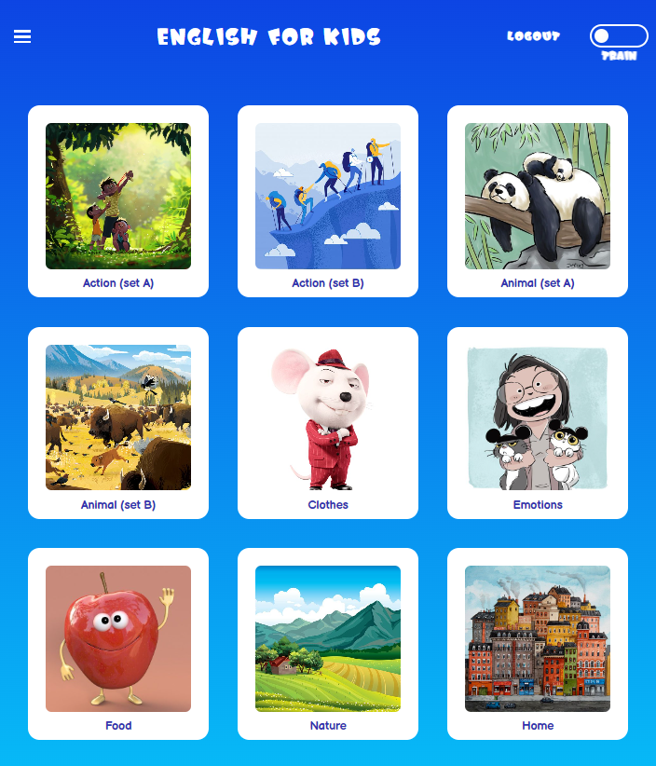
English
for kids
See project
Homyakova Alena

Slide 2










ABOUT PROJECT
Tech stack
Frontend side
Backend side
$200
MODELS
VIEWS
TEMPLATES

Slide 3
ABOUT PROJECT
Functionality
Multipage application for learning English vocabulary for kids.
Implemented train and play modes, statistics page and leaderboard.
Frontend side
Backend side
Game and train business logic, event listeners (click, load, etc.),
DOM API, Audio API for manipulating DOM elements including audio elements
AJAX and Fetch API for client-server communication
State management with Local Storage
Client-side statistics sorts
Responsive markup
Django administration
Authorization
login, logout, signup,
restricted areas with LoginRequiredMixin
Routing
Django class-based views
MySQL data storage, raw SQL queries and Django ORM queries, sorts, filters
User-specific leaderboard and stats
Data creation and storage to MySQL through Django shell

Slide 4
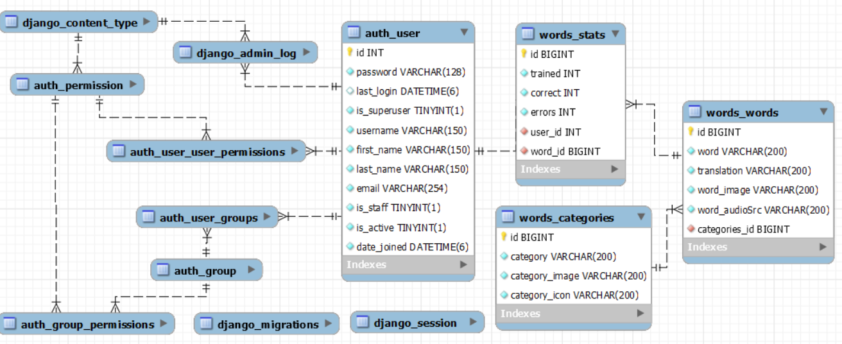
ABOUT PROJECT
MySQL Data Structure

Slide 5
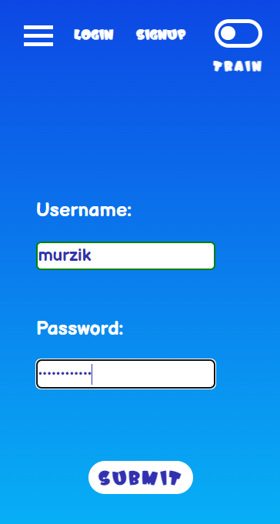
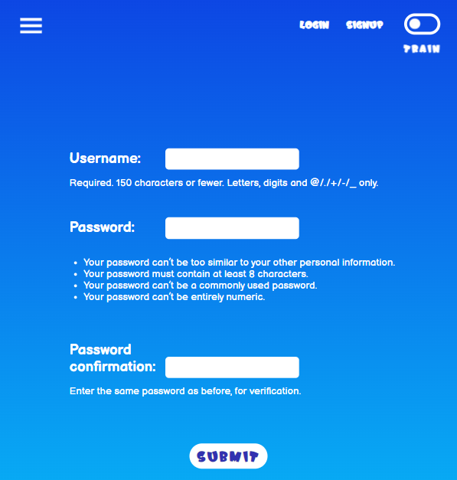

BUSINESS LOGIC
Authorization
LOGIN PAGE
SIGNUP PAGE
LOGOUT PAGE

Slide 6
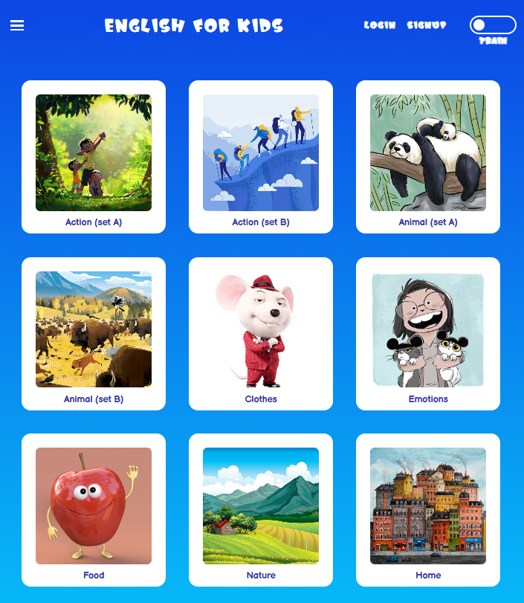
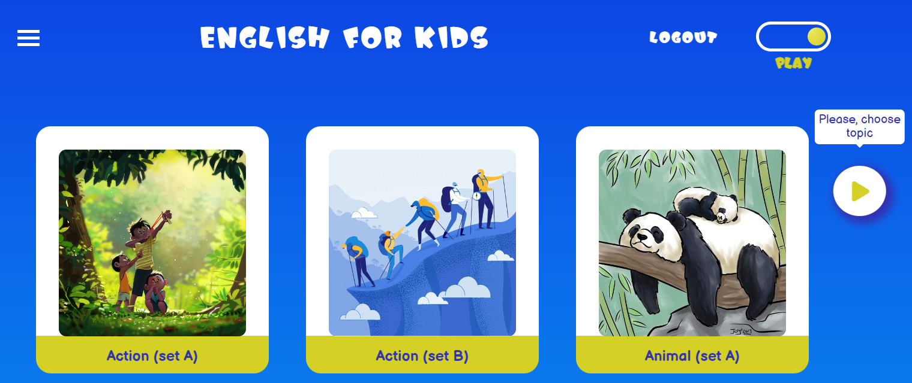
BUSINESS LOGIC
CATEGORIES PAGE
TRAIN MODE
PLAY MODE

Slide 7
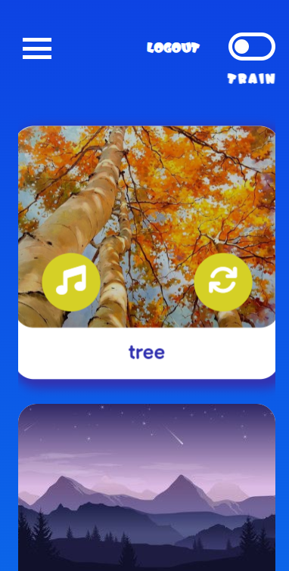
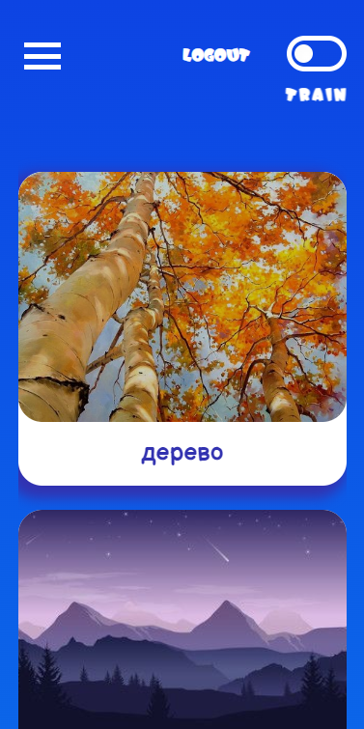
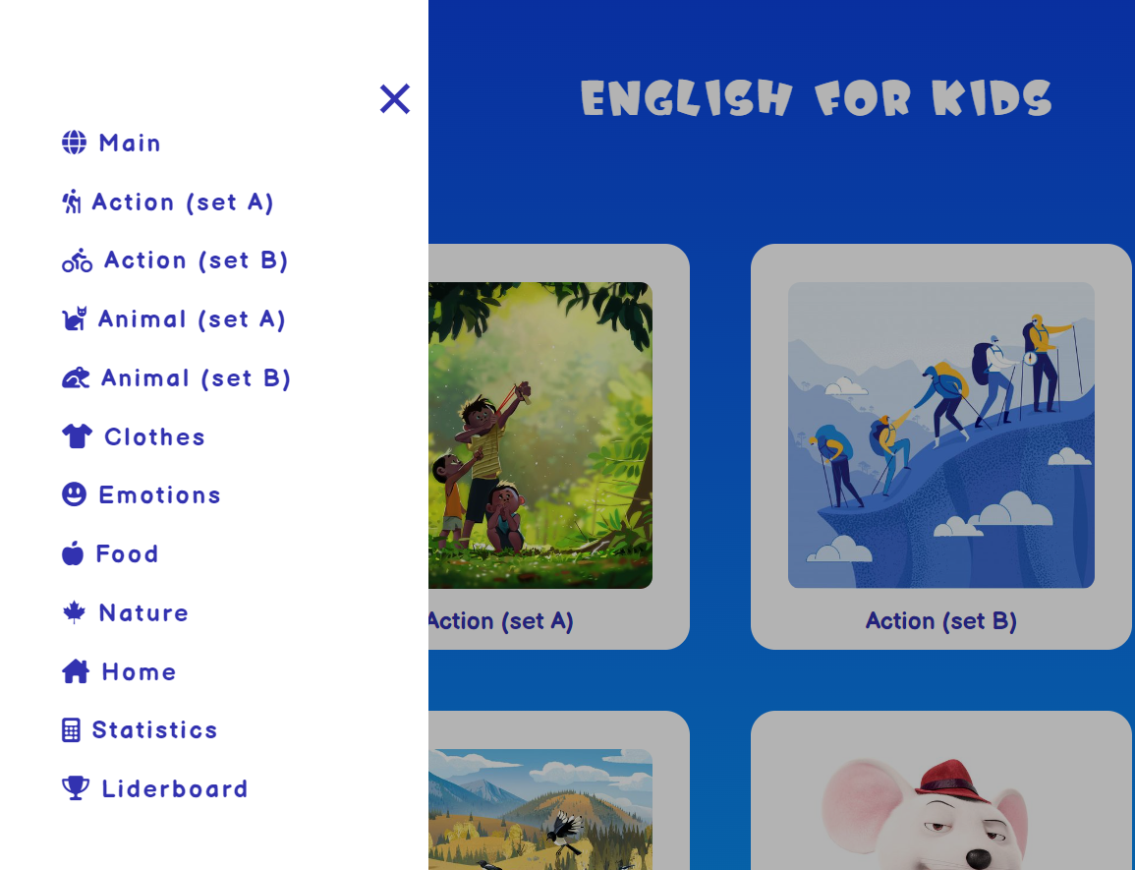
BUSINESS LOGIC
WORDS PAGES
WORDS PAGE: TRAIN MODE
NAVIGATION MENU: CHOOSING CATEGORY

Slide 8
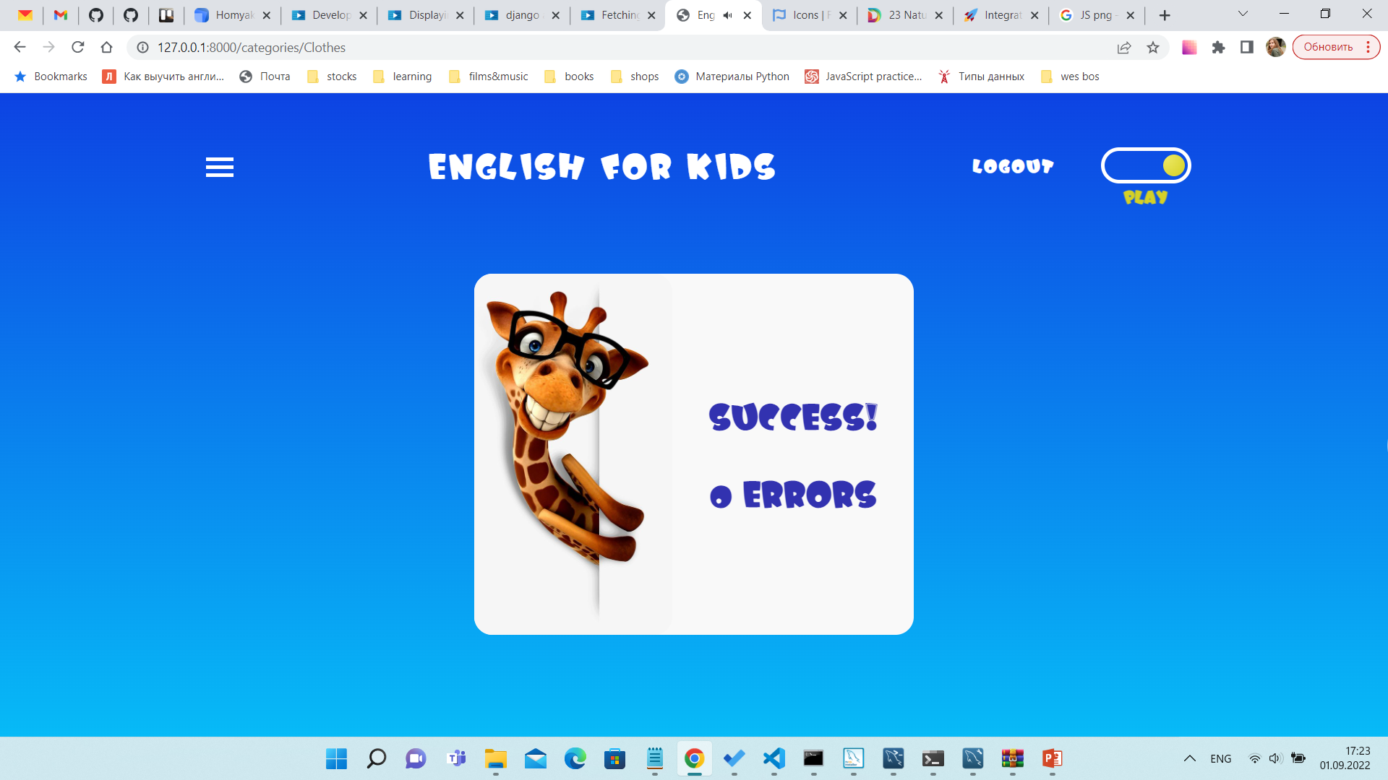
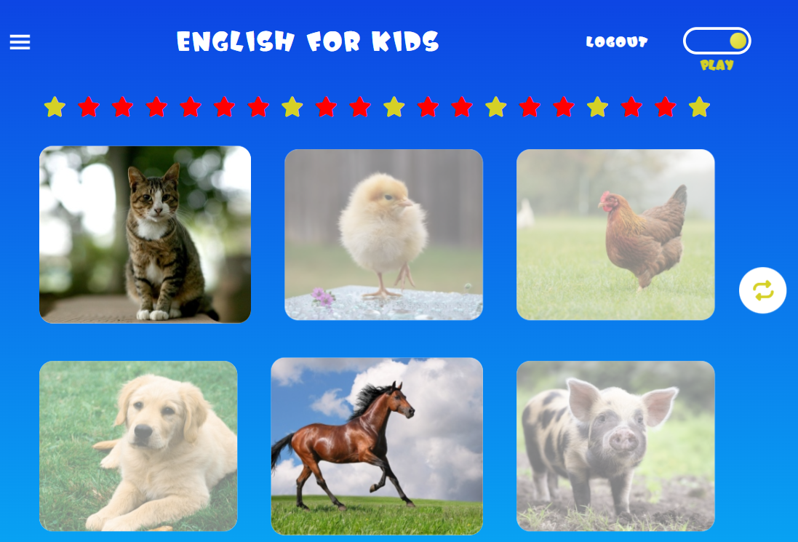
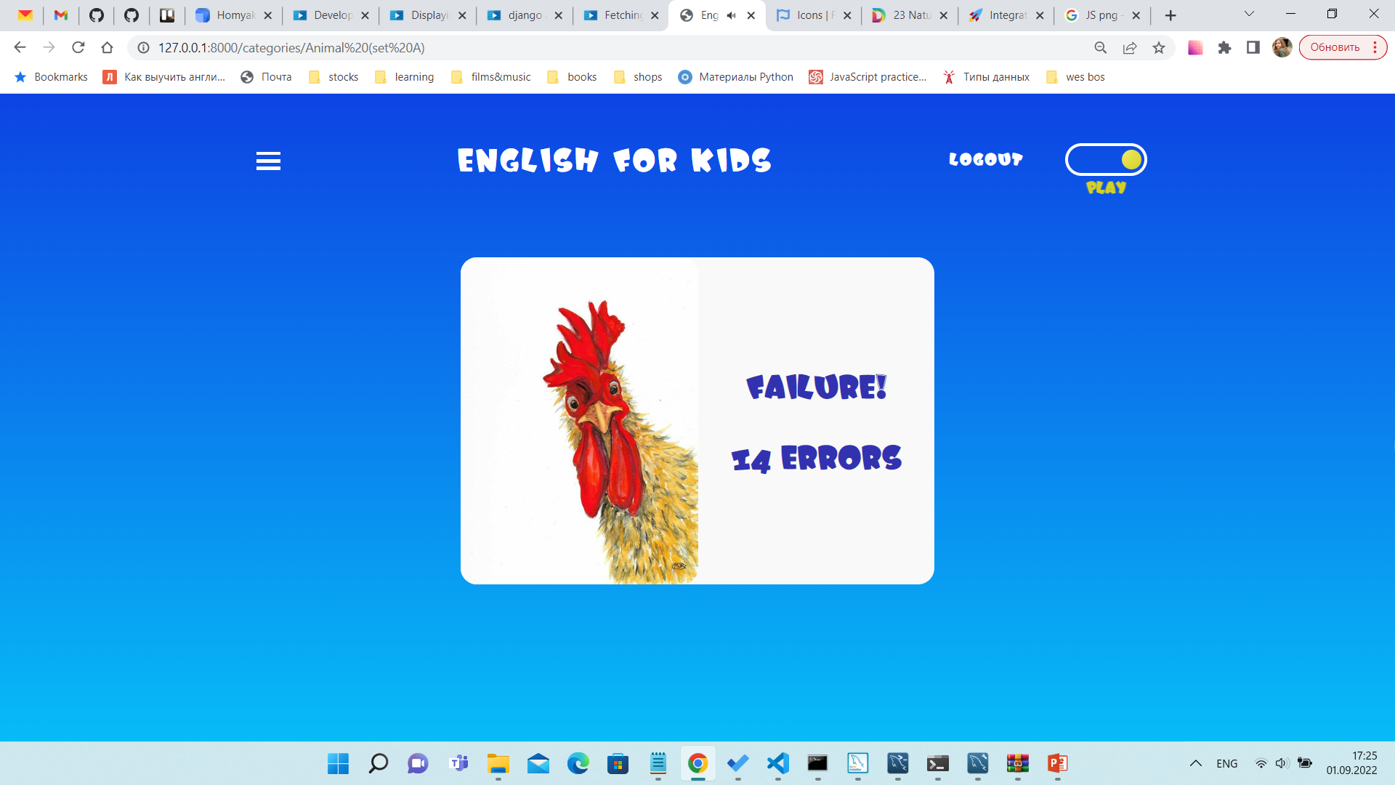
BUSINESS LOGIC
WORDS PAGES
AND GAME RESULT PAGES
SUCCESS PAGE
WORDS PAGE: GAME MODE
FAILURE PAGE

Slide 9
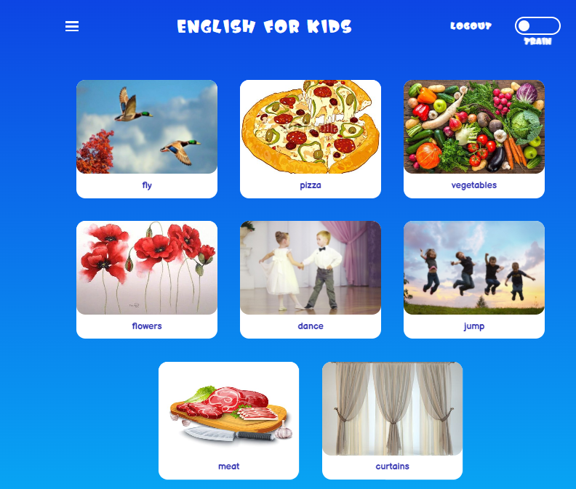
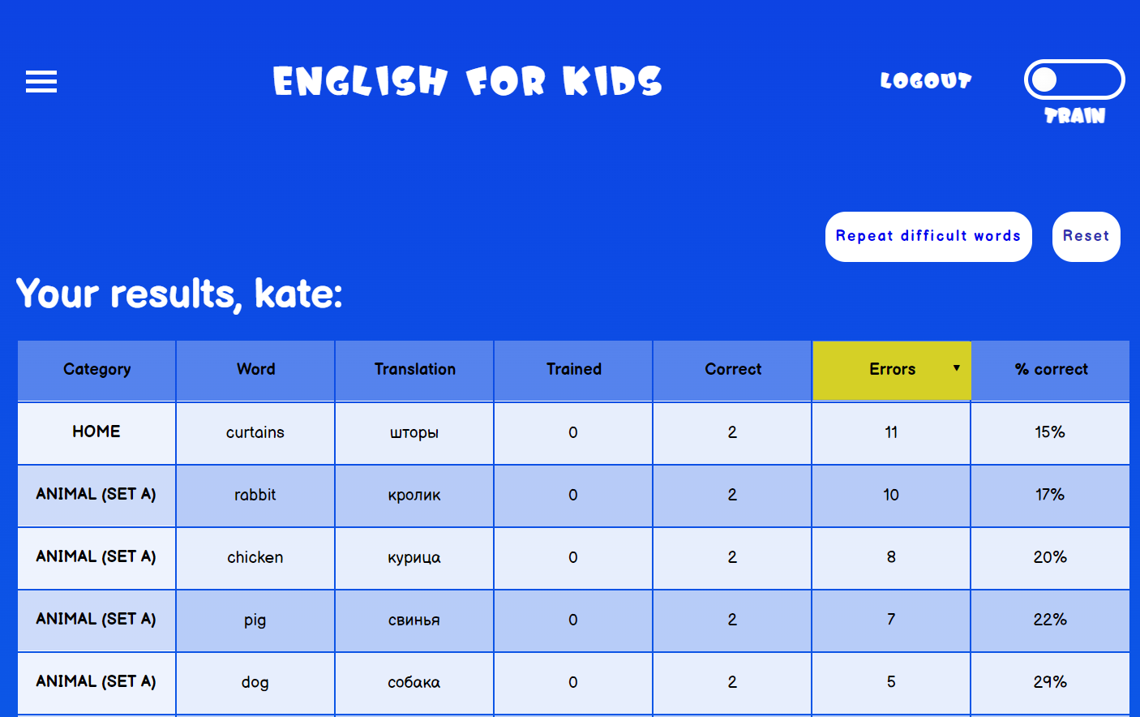
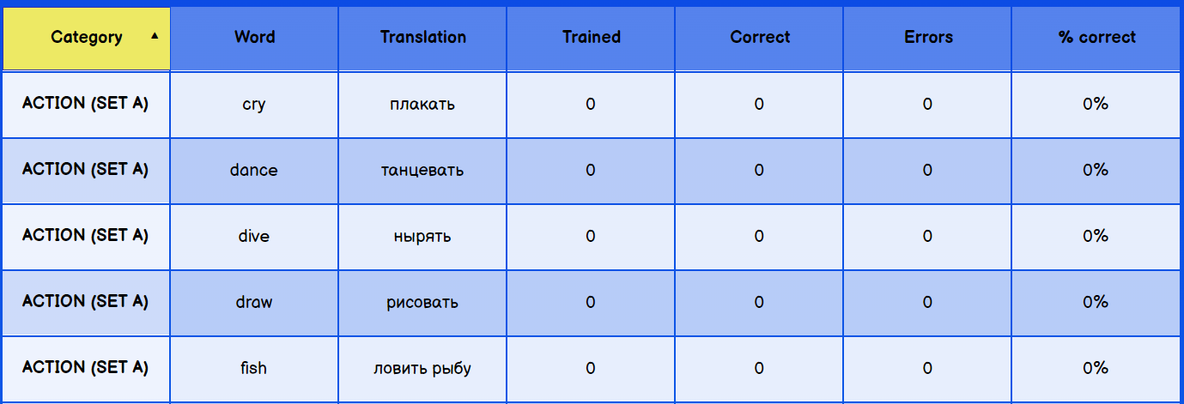
BUSINESS LOGIC
VIEW OF DIFFICULT WORDS WITH TRAIN AND PLAY MODE
STATISTICS PAGE
RESET OWN STATS OF THE AUTHORIZED USER

Slide 10
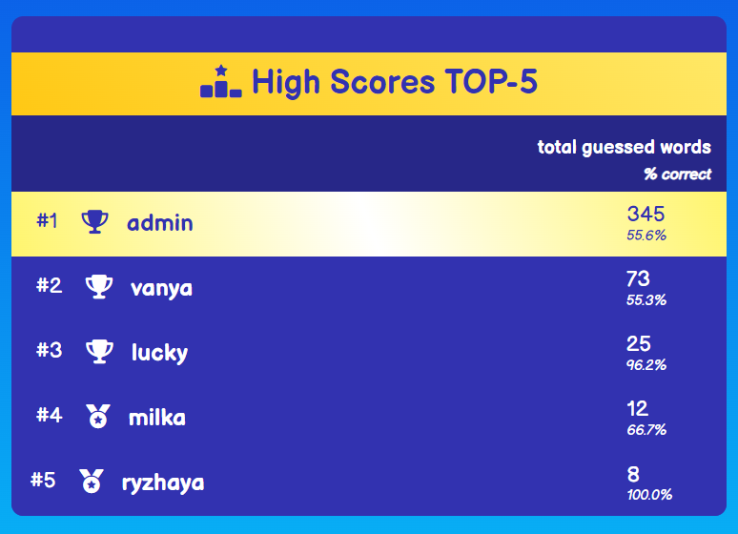
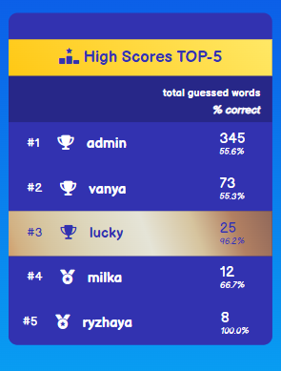
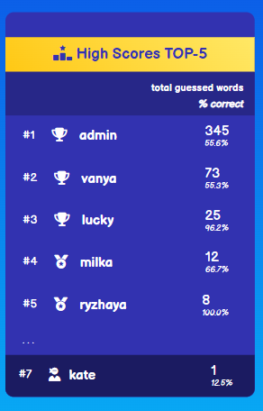
BUSINESS LOGIC
LEADERBOARD PAGE

Slide 11
ENGLISH FOR KIDS
Thank you
for your attention!

